Slide 1
Breast Cancer Prediction

Slide 2
Problem Statement
Need
Breast cancer is the second leading cause of cancer death and it is difficult to predict the stage of Breast Cancer.
Significance
By having a high-performance model it will be possible to predict the stage of Breast Cancer more efficiently.

Slide 3
Proposed Approach
Start
Breast Cancer Dataset
Choosing Different Models
Selecting Hyperparameters for these Models
Training
Evaluating these Models
Result Analysis
Prediction of the stage of Breast Cancer using best Model
Finding Optimal Features
End

Slide 4
Hyperparameters for Random forest
n_estimators: [9, 10, 15],
max_features: ['log2', 'sqrt','auto’],
criterion: ['entropy', 'gini’],
max_depth: [5, 10,30],
min_samples_split: [2, 3, 5],
min_samples_leaf: [1, 5, 8]

Slide 5
Best Hyperparameters For Random Forest
n_estimators=15
max_features=sqrt
criterion= entropy
max_depth=5
min_samples_split=2
min_samples_leaf=5

Slide 6
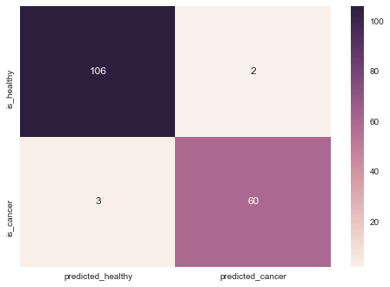
Confusion Matrix For Random Forest

Slide 7
Performance Metrics For Random Forest
 | Precision | Recall | F1-score | Support
0 | .9725 | .9815 | .9770 | 108
1 | .9677 | .9524 | .9600 | 63
Avg/Total | .9707 | .9708 | .9707 | 171

Slide 8
Hyper Parameters for K Nearest Neighbors
n_neighbors: [3, 4, 5, 10],
weights: ['uniform', 'distance’],
p:[1,2]

Slide 9
Best Hyperparameters For K Nearest Neighbors
n_neighbors=3
weights= uniform
p=2

Slide 10

Confusion Matrix For K Nearest Neighbors

Slide 11
Performance Metrics For K Nearest Neighbors
 | Precision | Recall | F1-score | Support
0 | .9720 | .9630 | .9674 | 108
1 | .9375 | .9524 | .9449 | 63
Avg/Total | .9593 | .9591 | .9591 | 171

Slide 12
Hyperparameters For Support Vector Machine:
'C': [1], 'kernel': ['linear'],
'C': [10], 'kernel': ['linear'],
'C': [100], 'kernel': ['linear'],

Slide 13
Best Hyperparameters For Support Vector Machine
C = 1
Kernel = 'linear’

Slide 14

Confusion Matrix For Support Vector Machine

Slide 15
Performance Metrics For Support Vector Machine
 | Precision | Recall | F1-score | Support
0 | .9907 | .9815 | .9860 | 108
1 | .9688 | .9841 | .9764 | 63
Avg/Total | .9826 | .9825 | .9825 | 171

Slide 16
A comparative analysis between all three models based on various performance metrics
Model | SVM | RF | KNN
Precision (%) | 98.26 | 97.07 | 95.93
Recall(%) | 98.25 | 97.08 | 95.91
F1-Score(%) | 98.25 | 97.07 | 95.91

Slide 17
Conclusion
A comparative performance analysis is done between Support Vector Machine, Random Forest, and K-Nearest Neighbors for finding out the best model for Breast Cancer prediction.
Support Vector Machine is found out to be most effective in prediction for Benign or Malignant stage of cancer with accuracy 98.25%, Precision 98.26%, Recall 98.25% and F1-Score 98.26%.

Slide 18
Thank You

